Slide 1
Cellular Respiration
Notes:
Copyright©USBIologyTeaching.Com
This PowerPoint is designed to be used with the curriculum at USBiologyTeaching.Com. The use of the presentation requires a license.

Slide 2
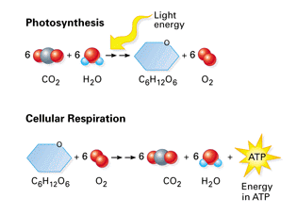
Cellular Respiration
When you eat food you get energy from breaking that food down into simpler molecules.
Cellular Respiration-a complex process in which cells make ATP (adenosine triphosphate) by breaking down organic compounds.
BOTH autotrophs (plants) and heterotrophs use Cellular Respiration.

Slide 3
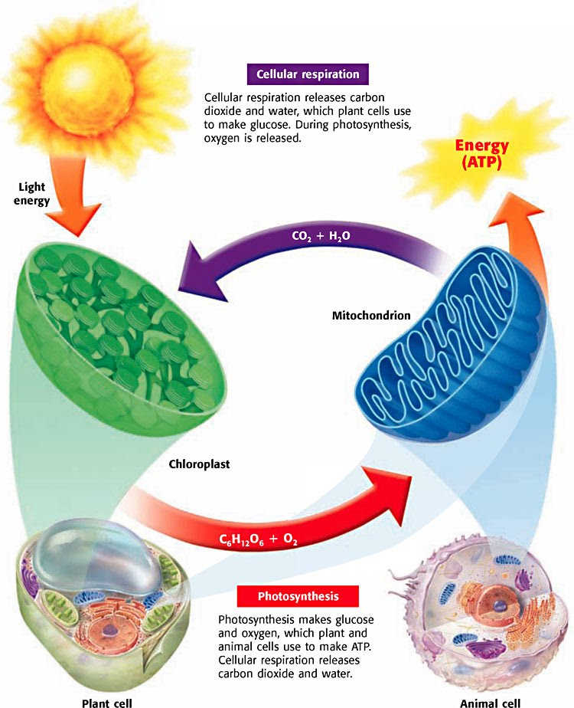
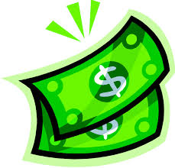
Cellular Respiration
The products of cellular respiration are the reactants of photosynthesis.
Cellular Respiration is divided into 3 stages.
Glycolysis
Aerobic Respiration (with oxygen)-Krebs cycle
Electron Transport Chain
The main focus is to get ATP (adenosine triphosphate) the universal energy molecule. It is like money.

Slide 4
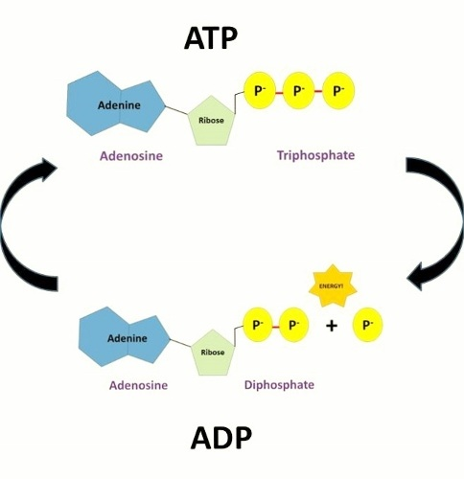
ATP
ATP is the universal energy currency in the cell. It has 3 phosphate groups attached.
It is a high energy molecule. When it releases a phosphate group it releases energy and it becomes ADP (adenosine diphosphate).

Slide 5
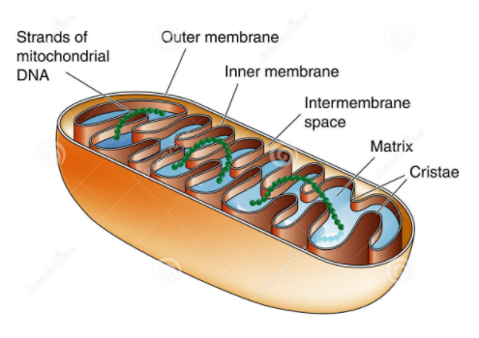
Where does cellular respiration occur?
It occurs in the cytoplasm (glycolysis) and the mitochondria.
Be able to label the part of the mitochondria

Slide 6
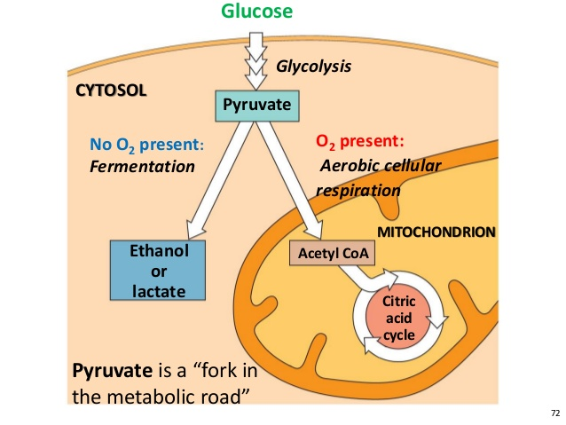
Glycolysis-The First Stage
A process where one 6-carbon molecule (glucose) is oxidized to create two 3-carbon molecules.
It is a series of chemical reactions that are catalyzed by specific enzymes.
Glycolysis take place in the cytosol.

Slide 7
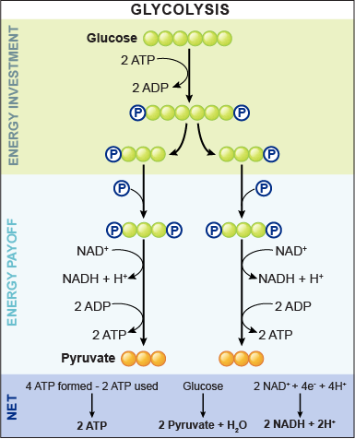
Glycolysis Steps
Two phosphate groups from 2 ATP are attached to glucose forming a new 6 carbon compound.
The six carbon compound is split into 2 3-carbon molecules called (glyceraldehyde 3-phosphate) or G3P.
Each G3P get a phosphate group added. Two molecules of NAD+ (electron acceptor) becomes NADH.

Slide 8
Glycolysis Steps
4. The phosphate groups are removed creating two molecules of pyruvic acid.
The 4 total phosphates that were removed combine with 4 ADP to make 4 total ATP.
However, 2 ATP were used up so the NET ATP for glycolysis is 2 ATP
Glycolysis net: 2 ATP, 2 Pyruvic acid +H₂0, 2NADH+2H⁺

Slide 9
Bell Ringer –Day 2
What is ATP?
Where does glycolysis occur?
What are the net products of glycolysis.
What is the function of NAD+ (NADH).
Notes:
Answers:
ATP is the universal energy molecule.
Glycolysis occurs in the cytosol.
The products of glycolysis are: 2 ATP, 2 Pyruvic acid +H₂0, 2NADH+2H⁺
NADH is an electron carrier.

Slide 10
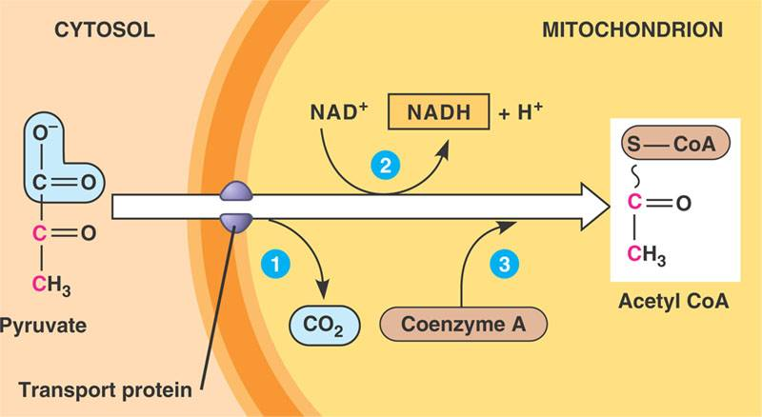
Part 2 of Cellular Respiration-Krebs Cycle
When the Pyruvic acid goes into the mitochondrial matrix it reacts with an enzyme called coenzyme A to create a two carbon molecule called acetyl CoA.
The Krebs Cycle is a biochemical pathway that breaks down a acetyl CoA producing CO2,ATP and hydrogen atoms.

Slide 11
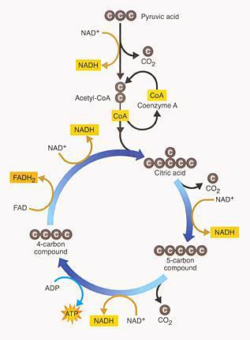
Step of the Krebs Cycle
PAY Special attention to the number of NADH and FADH2 that are created here. They will be used later to create a lot of ATP
Two-carbon acetyl CoA combine with four-carbon oxaloacetic (AHKS-uh-loh-uh-SEET-ik) acid to create a 6 carbon compound called citric acid.
Citric Acid releases CO₂ and a hydrogen atom to form a five-carbon compound. The electron of the hydrogen atom is transferred to NAD+ and reduces it to NADH.
The five-carbon compound releases CO₂ and a four-carbon compound is formed. ATP is synthesized from ADP.
Notes:
The students will not be assessed on the details in the USBT curriculum however, it is important that they understand that it is a series of chemical reactions and where the main producers of ATP come from. (NADH, FADH2 and ETC)

Slide 12
Krebs Cycle Steps Continued
4.The four-carbon compound that was formed releases a hydrogen atom and reduces a FAD+ (an electron acceptor, flavin adenine dinucleotide) to FADH₂
5. The new four-carbon molecule from step 4 releases a hydrogen molecule to regenerate the oxaloacetic acid and keep the cycle going. NAD+ is again reduced to NADH.
This entire process was for 1 pyruvic acid. Glucose produces two. 1 glucose require two cycles.

Slide 13
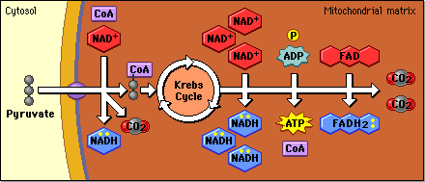
Kreb’s Cycle Summary-ONLY 2 ATP
1 Glucose Produces:
Four CO2-diffuses out of the cell as waste
Two ATP
Hydrogen Atoms that are used for:
6-NADH
2-FADH
These molecules are use in the next stage of aerobic respiration.

Slide 14
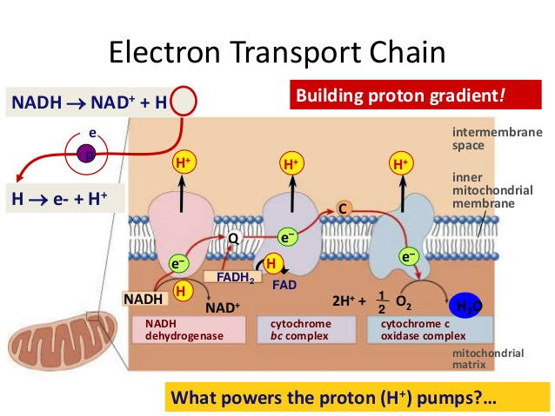
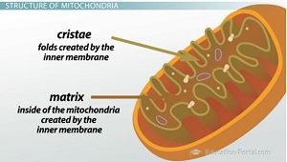
The Electron Transport Chain (ETC)
The electron transport chain uses chemiosmosis with the help of NADH and FADH₂ to produce ATP.
The ETC and the enzyme ATP synthase (makes ATP) is embedded in the inner membrane folds of the mitochondrion called the cristae.
In prokaryotes the ETC is in the cell membrane.

Slide 15
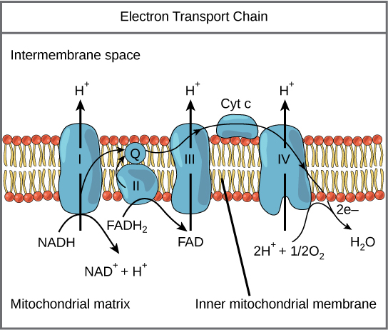
How is ATP made?
In order to understand how the ATP is made we must follow the electrons and protons of the NADH and FADH₂ that were produced during the Krebs Cycle.
The electrons of NADH and FADH donate their electrons to the molecules in the ETC. In addition to electrons the molecules give up H+ ions (protons).
They are passed down the ETC from molecule to molecule losing energy along the way.
The energy lost from the electrons is used to pump H+ to build a Higher H+ concentration on the inner membrane than the outer. This also creates an electrical gradient.

Slide 16
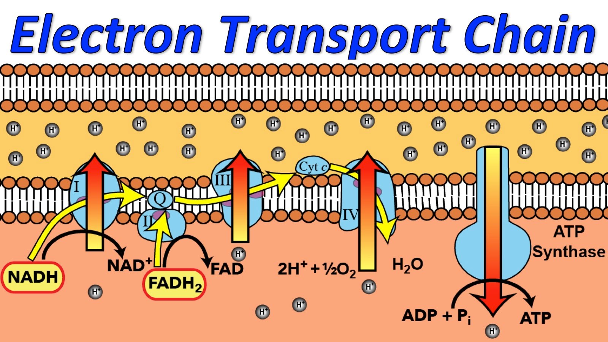
ATP Continued
4. The concentration gradient is used to synthesize ATP using chemiosmosis. This is the same way the ATP was made in photosynthesis.
During this process the protons move through the ATP synthase molecule and help build ATP from ADP molecules.
5.Oxygen, the final electron acceptor is used to unload the protons and form water. Without oxygen, the ETC would stop and so would ATP synthesis.

Slide 17
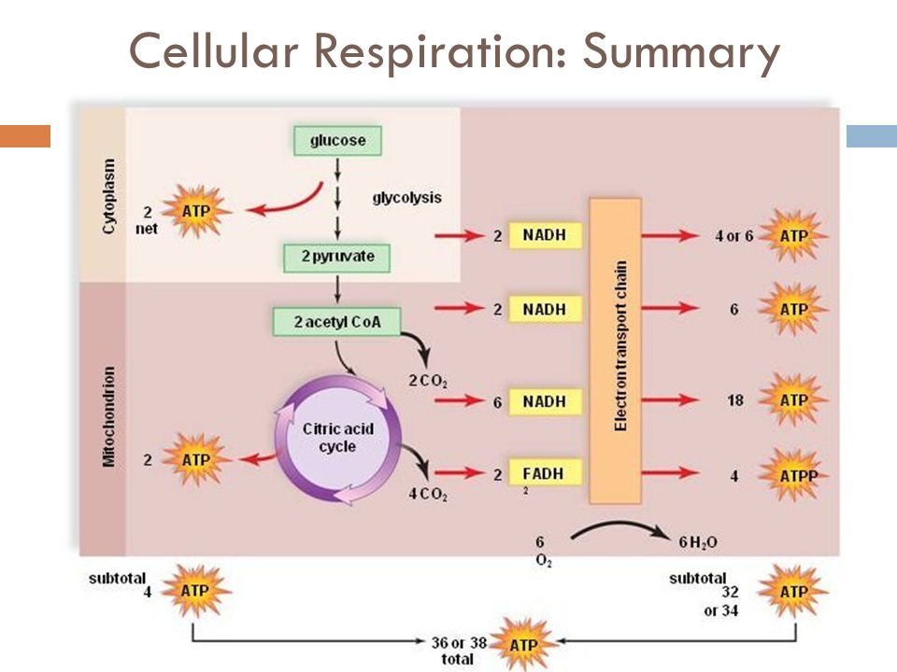
Summary of Aerobic (with oxygen) Respiration
In a perfect world 38 ATP are created during aerobic respiration.
ATP allows your cells to carry out almost all processes.
It is happening in your body right now.

Slide 18
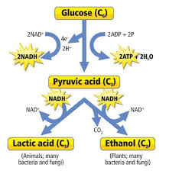
What happens when there is not oxygen?
Fermentation-the breakdown of carbohydrate without oxygen.
There are many type of fermentation pathways. We will focus on the two most common.
Lactic acid
Ethyl alcohol

Slide 19
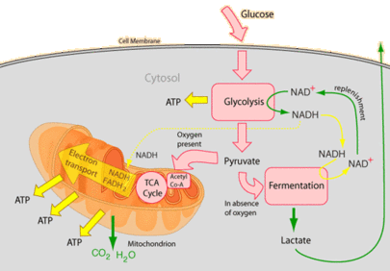
Lactic Acid Fermentation
Glycolysis still occurs-in the cytoplasm and creates pyruvic acid.
In lactic acid fermentation the pyruvic acid is converted to lactic acid.
ONLY 2 ATP are produced instead of 38 with aerobic respiration, this is why you eventually slow down when sprinting.
The lactic acid causes a temporary burning sensation in your muscles. Muscle movement slows and eventually stops due to the lack of ATP.

Slide 20
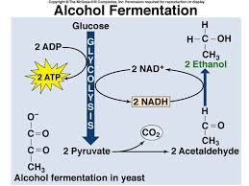
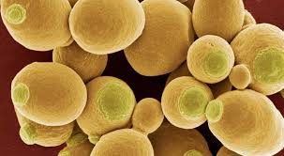
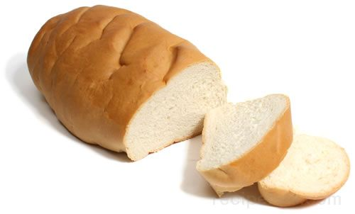
Ethyl Alcohol Fermentation
Also known as alcoholic fermentation
Converts pyruvic acid into ethyl alcohol.
CO₂ and ethyl alcohol are produced.
Yeast (a type of fungi) use ethyl alcohol fermentation.
They are used to create breads wine and beer.
Air pockets are created from the CO₂

Slide 21
Bell Ringer-Day 4
What type of cells in your body do you think have the most mitochondria? Why?
Notes:
Answer: Cardiac Muscles- they have about 5000 mitochondria per cell and the mitochondria in cardiac muscle have more cristae folds increase ATP production.
Typical Cells have around 1000-2000. The sperm cell has only 25-50.

